Slide 1
How Sickle Cell Disease Impacts a Student's Education
Allison King, MD, MPH, PhD
Professor
Washington University School of Medicine
Department of Pediatrics, Division of Hematology and Oncology

Slide 2
Objectives
Understand the significant health complications that commonly occur among students with sickle cell disease
Understand the common cognitive deficits that occur among students with sickle cell disease
Understand the evidence for interventions to support students with sickle cell disease

Slide 3
Sickle Cell Disease
Autosomal recessive point mutation
Abnormal hemoglobin: S, beta-thalassemia, C, and others
Trait is protective against malaria
US: 100,000 Americans with SCD
90% African American
10% Hispanic, Asian, Mediterranean
Worldwide: > 300,000 babies born yearly with SCD
Cure: stem cell transplant, potentially gene therapy
Hassell, K. L. (2010). Am J of Preventive Medicine, 38(4 Suppl), S512-521
Notes:
For a brief introduction to SCD: This is an inherited disorder. It is autosomal recessive and caused by a point mutation in the beta globin gene that results in abnormal hemoglobin. Patients may have Hb S with S, C, beta thalassemia and other more rare hemoglobins. The only cure is a stem cell transplant, and this is not a common option as a donor source is a challenge.
We think that there are ~100,000 people in the US with this disease. Over 90% are African American. There is a minority of people from areas of the world where malaria was a problem. The trait is protective against malarial infection, and this selection preserved the trait in populations over generations.
While most of my talk focuses on the population in the US, I want to acknowledge that the overwhelming majority of people with SCD are in subSaharan Africa. Over 300,000 babies are born with this disease each year, but it is difficult to estimate the total world population of SCD due to a lack of universal screening or tracking mechanisms.

Slide 4
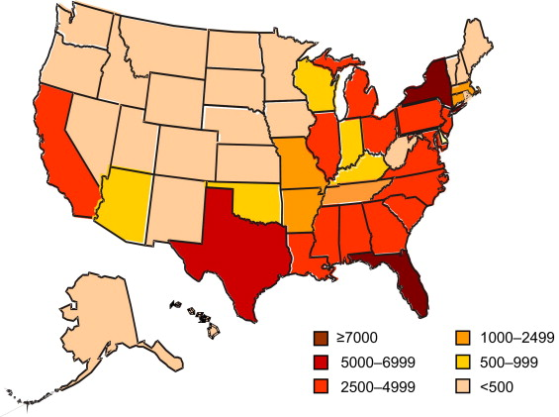
Sickle Cell Disease in the US
MO ~2500
Hassell, K, American Journal of Preventive Medicine 2010, 38, 4: S512-S521
Notes:
Sickle cell disease is an autosomal recessive disease which currently affects over 70000 people in the US, primarily African Americans, with approximately 1000 new births each year.
Estimated number of individuals with SCD, based on state-specific African-American and Hispanic birth-cohort disease prevalence and 2008 U.S. Census population, corrected for early mortality SCD,
Population Estimates of Sickle Cell Disease in the U.S.
Hassell, Kathryn L., MD, American Journal of Preventive Medicine, Volume 38, Issue 4, Supplement, S512-S521
Copyright © 2010 American Journal of Preventive Medicine

Slide 5
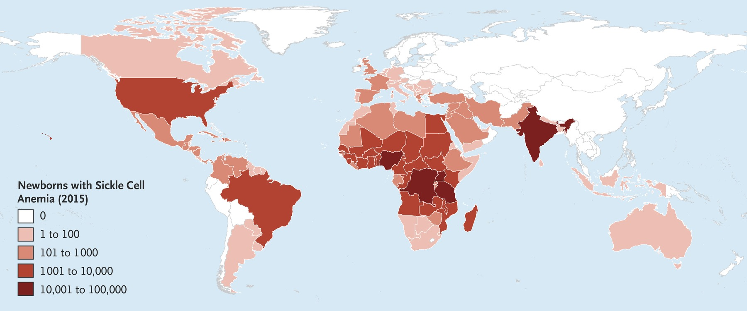
Global Sickle Cell Disease
N Engl J Med 2017; 376:1561-1573

Slide 6
ickle Cells
Fragile
Short Survival
(15-20 days vs. 120 days)
Rigid and inflexible
Chronic hemolysis - increased bilirubin
Can become stuck and form plugs in small blood vessels
Notes:
This slide shows the abnormal red blood cells in someone with SCD. The cells are fragile and live only 2-3 weeks compared to an unaffected RBC lasting 3-4 months. The sickle cells break down easily, can plug blood vessels that cause complications. The inflammation from this process also contributes to morbidity.

Slide 7
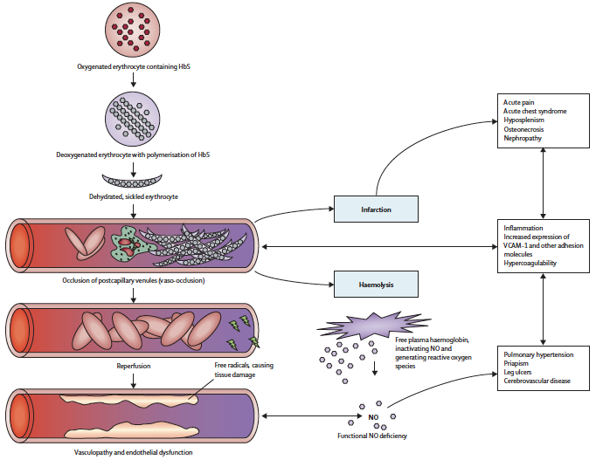
Pathophysiology of Sickle Cell Disease
Lancet. 2010;376(9757):2018–2031
Volume 376, Issue 9757, 11–17 December 2010, Pages 2018-2031

Slide 8
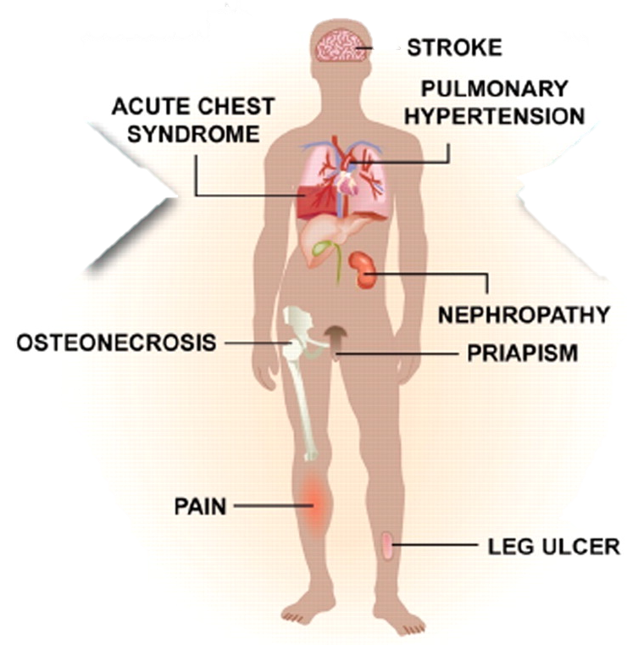
Clinical Manifestations of Sickle Cell Disease
Idowu Akinsheye et al. Blood 2011;118:19-27
Notes:
Sickle erythrocytes are a mixture of cells with measurable HbF (F cells) and non-F cells. F cells are long lived, do not acquire the same increment of HbS-induced damage as non-F cells, are less likely to initiate adhesive events, and are associated with protection from sickle vaso-occlusion (left arrow). The heterocellular distribution of HbF in sickle cell anemia, even when total HbF concentrations are high at baseline or in response to hydroxyurea, means that some erythrocytes with no HbF or with suboptimal concentrations of HbF are present. Some of these cells hemolyze intravascularly liberating hemoglobin, which scavenges nitric oxide and contributes to certain vascular complications of this disease (right arrow). This might account for the failure of high HbF that is heterocellularly distributed to protect against all disease complications.

Slide 9
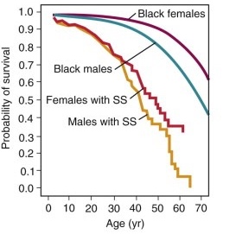
Median Life Expectancy is ~30 years Shorter than Expected
Platt OS, Brambilla DJ, Rosse WF, et al: N Engl J Med 1994, 330:1639
Notes:
The life expectancy of patients with sickle cell anemia remain significantly below their health counterparts
With the advent of supportive therapies such as hydroxyurea, which increases the amount of circulating fetal hemoglobin, and refined used of chronic transfusion therapy there has been an improvement in overall survival
This was further corroborated by a later study, the Multicenter Study of Hydroxyurea (1995) which assessed the efficacy of HU and found positive clinic outcomes in adults

Slide 10
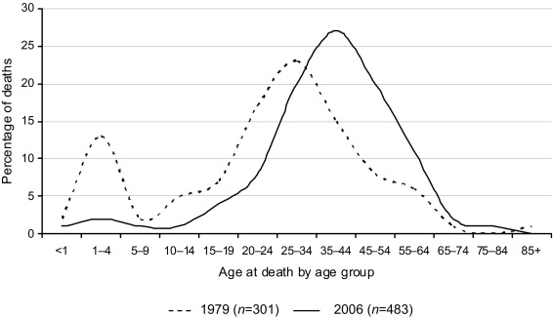
Age of Death by Age Group
Hassell, Kathryn L., MD, American Journal of Preventive Medicine, Volume 38, Issue 4, Supplement, S512-S521
Copyright © 2010 American Journal of Preventive Medicine
Notes:
1973: Median survival with SCD = 14 years
Was a peak in deaths between 1-3 years of age
1970’s to now: Newborn screening
1986: Prophylactic Penicillin Study (PROPS)
RCT of PCN vs. placebo in children < 3 years with SCD
84% reduction in pneumococcal infections in PCN arm
PCN became standard care at newborn screening
1993: Median survival with SS ~42 years
SC ~ 62 years
Over 90% live > 18 years
Gaston et al, NEJM 1986; Platt et al, 314:1593; NEJM 1993; 330:1639
Mortalilty begins to rise in adolesence
Nonetheless, even with these supportive therapies the life expectancy for patients with SCD remains low. (This graph demonstrates the peak age at death which has increased from ~30 to ~44 years as of 2006). While life expectancy has increased it still remains low.
Age at death for individuals with SCD in 1979 and 2006 SCD, sickle cell disease
Population Estimates of Sickle Cell Disease in the U.S.
Hassell, Kathryn L., MD, American Journal of Preventive Medicine, Volume 38, Issue 4, Supplement, S512-S521
Copyright © 2010 American Journal of Preventive Medicine

Slide 11
A Nearly Invisible Condition: Vulnerable Children
No obvious physical finding of sickle cell disease
Children and their families need to disclose
Pain cannot be measured by labs
We rely on the self-report of the child

Slide 12
Common Complications

Slide 13
Pain - Vaso-occlusion
Higher risk when:
Weather changes
Extreme cold
Extreme heat
Barometric changes
Dehydration
Inflammation
Infection
Recent immunization
May have scleral icterus
Treatment
Tylenol
Ibuprofen
Warm pack to area
Oral opioid
Usually on the way home or at home
Better to treat with NSAIDs early

Slide 14
Anemia
Hallmark of the condition
Chronic
Children have usually adapted
Signs of acute anemia
Pale conjunctiva
Shortness of breath
What to do?
Call the parent and/or clinic
May need a transfusion, but rare
https://www.pathkindlabs.com/blog/What-are-the-signs-of-Anemia-and-how-to-prevent-it

Slide 15
Spleen Complications
Functionally asplenic
High risk for infection
Encapsulated organisms
Can sequester
Abdominal pain
Acute anemia
Emergency
Can rupture with rough contact
https://my.clevelandclinic.org/health/diseases/17953-ruptured-spleen

Slide 16
Fever
Emergency in SCD
Must be evaluated by a provider if > 101.5F
Needs antibiotics
Risk of acute chest
Vaso-occlusion in lung
Chest pain
Needs to be seen emergently

Slide 17
Kidney Changes
Hyperfiltration
With anemia, the GFR is higher
Make more urine
Hyposthenuria
Less concentrated urine
Risk of dehydration
Accommodations
Water bottle
Frequent restroom breaks

Slide 18
Other Situations
Injury?
Ice is typically avoided
Gym class?
Can participate as physically able
Avoid contact sports
Spleen
Recess in extreme weather?
Better to stay inside
Can trigger pain
May need transportation accommodations for weather

Slide 19
Stroke/Cerebral Infarct
Overt
Hemiparesis
Bad headache
Aphasia
An emergency
Child needs to be seen ASAP
Would need an exchange transfusion of blood
Silent
Typically, no obvious gross neurologic sign

Slide 20
Silent Cerebral Infarcts are Common
Kassim et al Blood 2016 127(16):2038

Slide 21
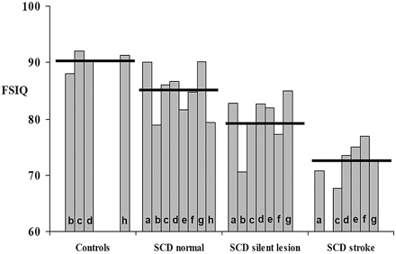
Silent Cerebral Infarct and Stroke Impact Cognition
DeBaun et al Blood 2012 119 (20):4587

Slide 22
Cognitive Deficits seen in SCD
Executive function
Impulsivity
Attention
Working memory
Processing speed
Self-awareness of deficits
Potential misinterpretations
Not listening
Not paying attention
Troublemaker
We see a progressive decline in cognition over time
Notes:
No real medical interventions
Will talk through some rehabilitation interventions focusing on metacognitive strategy use

Slide 23
Domain Specific Assessments are Needed for Interventions at School
Executive function
Cues for organization
Multi-step activities need simpler chunking
Routine
Processing speed
Provide notes and recordings
Extended test periods
Attention
Preferential seating
Reduce distractions
Medications, if needed

Slide 24
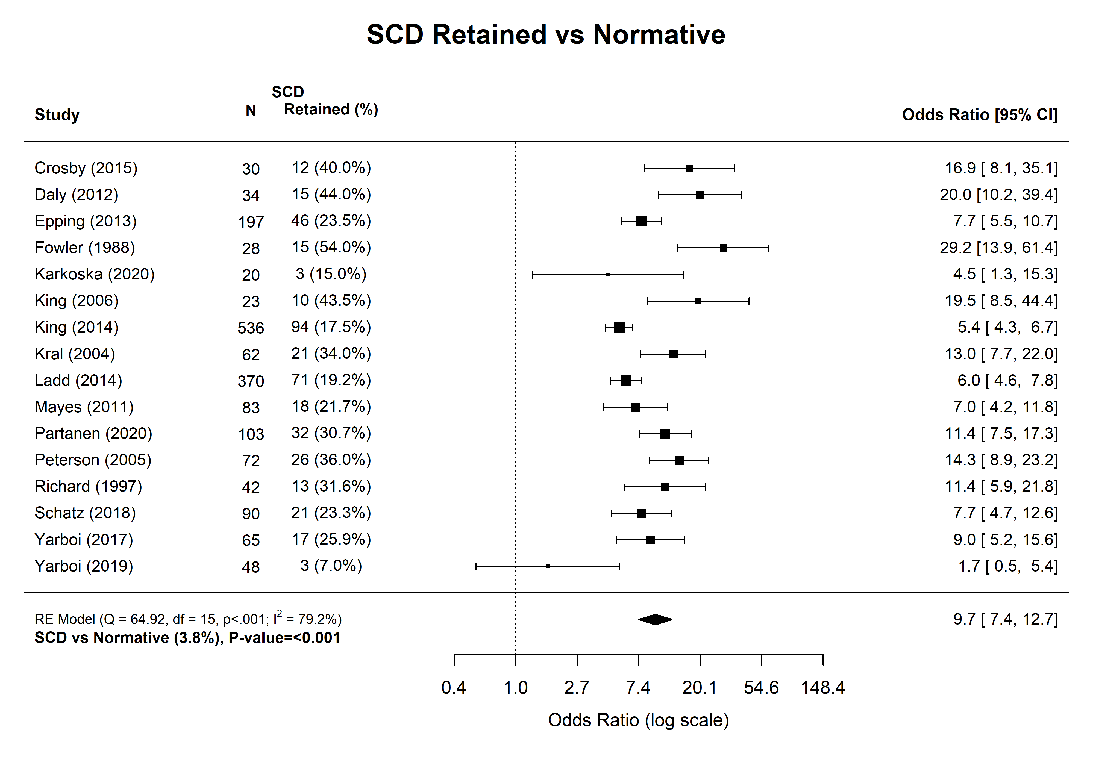
Students with SCD are 10x More Likely to be Retained a Grade
Front Neurol. 2021 Dec 13;12:786065

Slide 25
Increased Grade Retention
Over 60% of children with SCD and SCI have either experienced grade retention or received special education services
~27% of students with SCD will experience grade retention at least once throughout their K-12 education
Comparison
2.6% of all students
3.0% of African Americans
J Pediatr Psychol. 2004;29(8):627-633.
https://nces.ed.gov/programs/raceindicators/indicator_rda.asp

Slide 26
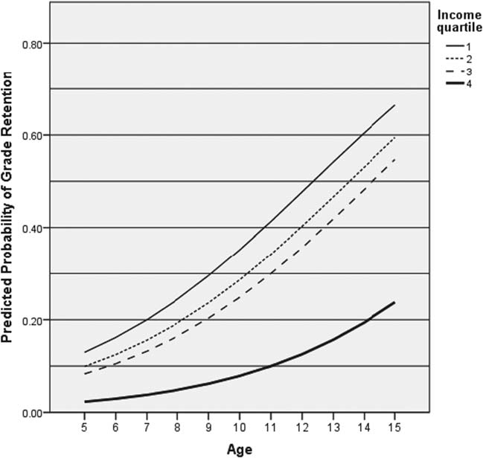
By Age 15, 65% of Poor Males with SCA Fail
King et al, AJH 2014, 89:E188-E192

Slide 27
Screen for Educational Performance
Educational inventory in clinic
Performance in school – recent change? Failure?
Refer for neuropsychology evaluation and share results with school
Educational liaison/advocacy
504 Plan
Intermittent homebound tutoring
Water bottle at desk
Frequent restroom breaks
Extended time for tests
Pain plan
IEP (Special Education Services)
Smaller groups
Modified instruction
Alternative methods of assessment
Vocational education

Slide 28
School Liaison
Sonya Burnett, MPH
School liaison at St. Louis Children’s Hospital
bsonya@wustl.edu

Slide 29
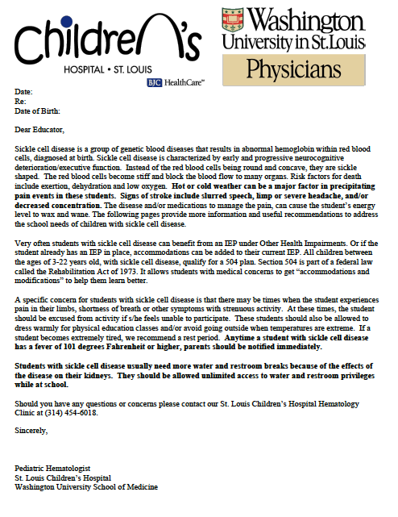

Slide 30
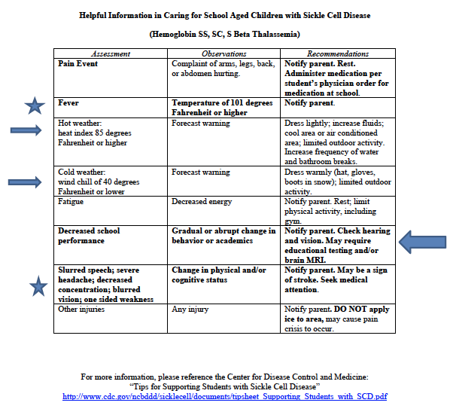

Slide 31
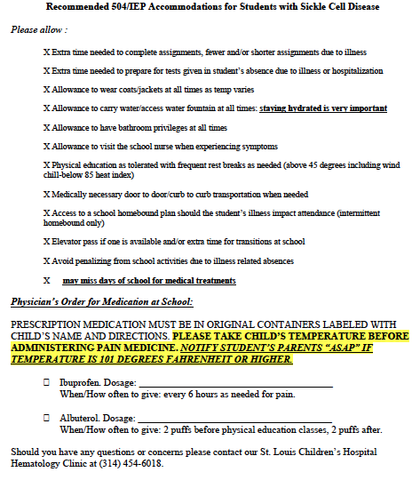

Slide 32
A High Risk Yet Underrecognized Population of Students
Your knowledge can positively impact the student
Improve accommodations
Reduce bias

Slide 33
What are we doing to help?
Conducting a needs assessment of school districts and personnel to understand the needs to support students with sickle cell disease.
Plan to offer support to districts in the future to assist.

Slide 34
Are you interested in helping?
Would you be interested in participating in our work addressing sickle cell disease awareness and knowledge throughout our state?
We would like to hear from school nurses to better understand your needs and the needs of your students and school.
https://redcap.wustl.edu/redcap/surveys/?s=3NLTJXY94CPK3H4W

Slide 35
We need to work together!
Community
Clinical
Schools

Slide 36
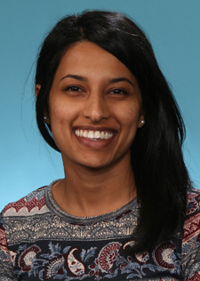
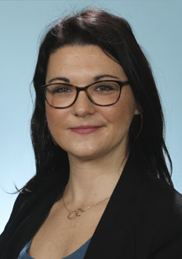
Acknowledgements “The Village”
Taniya Varughese, MSOT, OTR/L
Lab Members:
Lisa Garrett
Lingzi Luo
Abigail Picinich, MS
Nai Qashou
Ayu Frazier, PhD
All of the families who have participated in our studies
Funding Agencies
NHLBI
NINDS
HRSA
Doris Duke Charitable Foundation
American Heart Association
American Society of Hematology
WU CTSA
Kelly Harris, PhD
Catherine Hoyt, OTD, PhD

Slide 37
Questions? If you would like to learn more or be a part of future efforts, please email me!
Allison King, MD, MPH, PhD
king_a@wustl.edu

